Slide 1

Hotel
Booking Cancellation
Prediction
A Supervised Machine Learning Approach to Pattern Recognition

Slide 2

01
The Real-World Problem
Hotels suffer from "Revenue Leakage" when guests cancel at the last minute. If a room stays empty, its value for that night is lost forever.
Our Solution:
We built a Pattern Recognition system using Machine Learning. By analyzing historical data, the model learns the "patterns" of guests who are likely to cancel (e.g., long lead times, specific countries, or no-deposit bookings). This allows hotel management to take proactive actions, like sending reminders or managing overbookings scientifically.

Slide 3
02
Fayoum Branch
OUR TEAM
01
02
03
Youssef Ayed
2301475
Mohamed Karem
2301788
Mohamed Mahmoud
2302068
04
05
06
Asmaa Khaled
2302018
Amany Thabet
2303121
Khloud Ibrahim
2303569

Slide 4
03
Project Overview
Data .1
Cleaning
Exploratory .2 Data Analysis
(EDA)
Feature .3 Engineering & Pre-processing
Model .4
Training & Evaluation

Slide 5

01
Data Cleaning

Slide 6
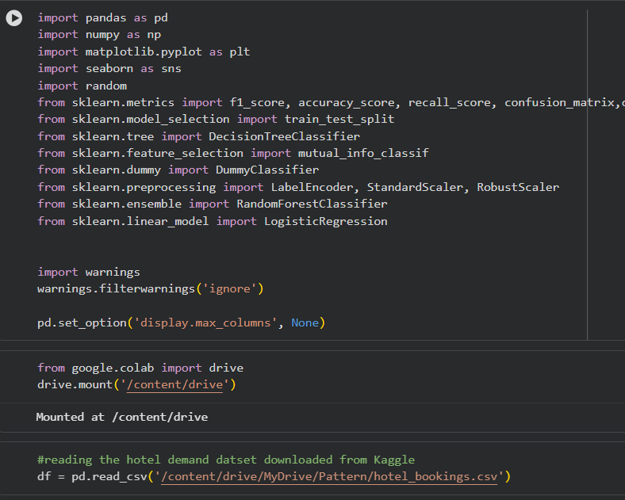
Data Cleaning
Step 1: Environment & Library Setup
Setting up the environment: by mounting Google Drive to acquire and load the Hotel Demand dataset into a Pandas DataFrame.
Core Data Handling: Importing Pandas and NumPy for efficient data manipulation and numerical operations.
Data Visualization: Importing Matplotlib and Seaborn to create graphs and discover visual patterns in hotel data.
Machine Learning Tools: Importing Scikit-Learn utilities for data splitting, encoding categories, and training models like RandomForest and DecisionTree.
Display Optimization: Configuring the environment to suppress software warnings and ensure all dataset columns are visible during analysis.

Slide 7
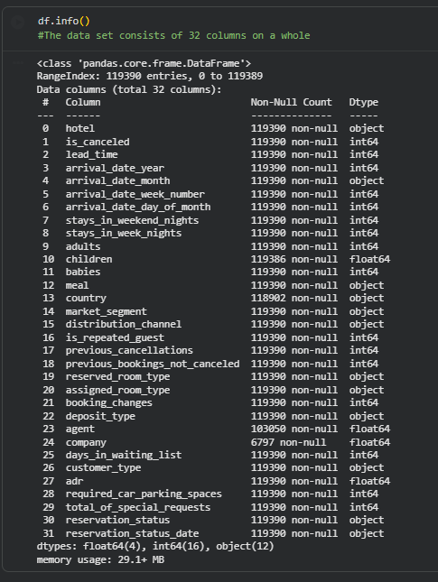
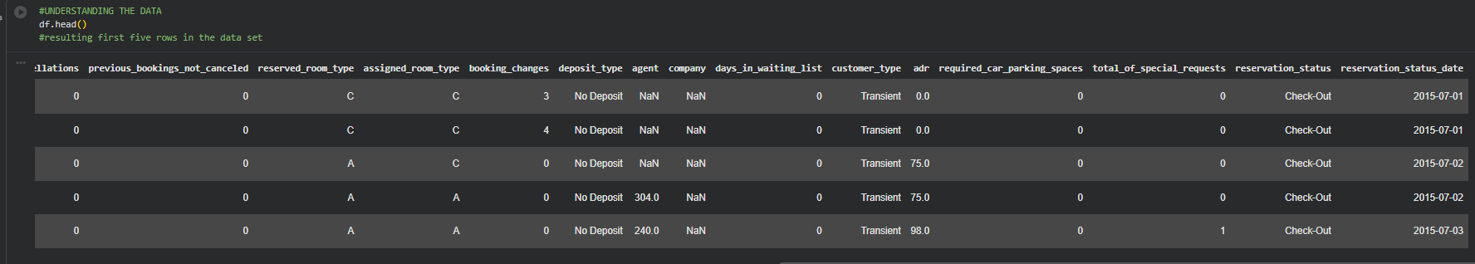
Data Cleaning
Step 2: Data Exploration & Understanding
Initial Data Preview: Using df.head() to display the first five rows of the dataset, providing an immediate look at features like booking types, lead times, and guest details.
Structural Overview: The df.info() command confirms the dataset consists of 119,390 entries across 32 columns.
Data Diversity: The dataset contains a mix of data types, including 12 categorical (object), 16 integer (int64), and 4 floating-point (float64) columns.
Identifying Missing Values: Initial inspection reveals missing data in critical columns such as children, country, agent, and company, which will require cleaning in subsequent steps.

Slide 8
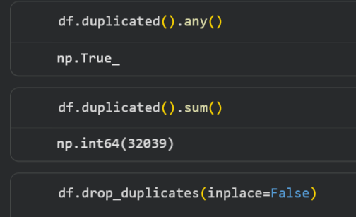
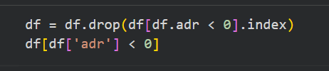
Data Cleaning
Step 3: Removing Duplicates
Detecting Duplicates: We use df.duplicated().any() to check if there are any identical rows in the dataset, which returned True.
Quantifying Noise: The sum() function reveals that there are 32,039 duplicate records, representing redundant information that could bias our pattern recognition.
Data Purification: We execute df.drop_duplicates() to remove these redundant entries, ensuring that each booking in the final dataset is unique and the model learns from actual individual behaviors
Step 4: Drop Unnecessary Columns.
Action: Dropping records where the Average Daily Rate (ADR) is negative.
Purpose: Negative prices are data entry errors that distort revenue-based predictions.
Verification: Ensuring the numerical range of our features is realistic before proceeding to the scaling phase

Slide 9
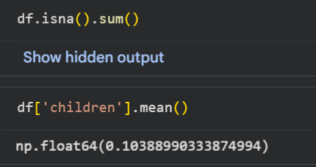
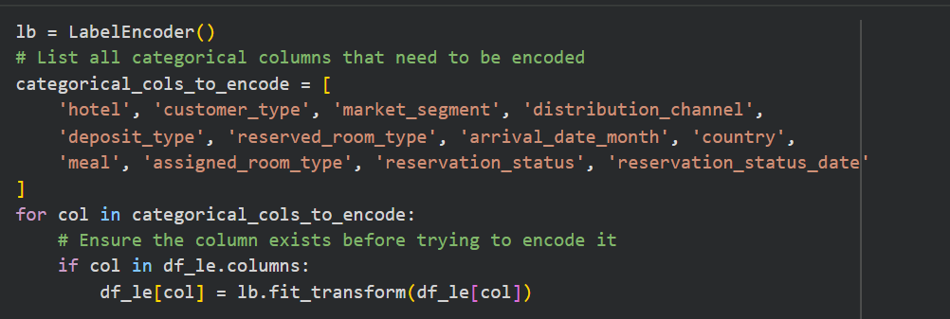
Data Cleaning
Step 5: Handle Missing Values
Identifying Gaps: We execute df.isna().sum() to calculate the total number of missing entries across the dataset.
Statistical Analysis: We calculate the mean of the children column, which results in a decimal (~0.104).
Imputation Strategy: Since a count of children must be a whole number, this statistical check helps us decide that filling missing values with the Mode or Median (0) is more logical than using the mean.
Step 6: Categorical Label Encoding
Action: Transforming text-based categories into machine-readable integers.
Method: Applying LabelEncoder across 12 key features, including market_segment and country.
Outcome: Converts qualitative labels into numerical inputs required for mathematical model training.

Slide 10

02
Exploratory Data Analysis (EDA)

Slide 11
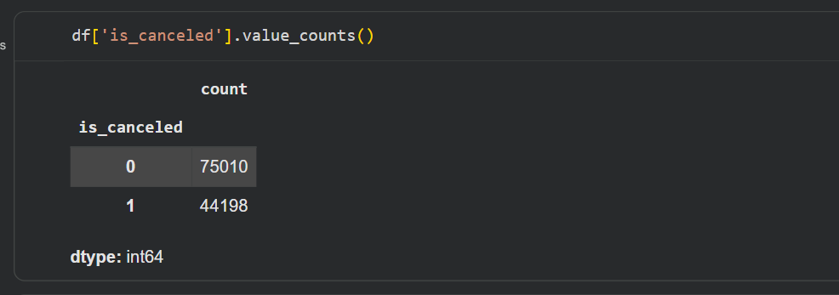
Exploratory Data Analysis (EDA)
Understanding Cancellation Drivers
Guest Behavior & Commitment
Purpose: Analyzing relationships between booking features and the target variable (is_canceled) to identify patterns.
Lead Time Impact: We observed that bookings with longer lead times significantly increase the probability of cancellation.
Pricing Insights: Higher Average Daily Rate (ADR) values often show a positive correlation with cancellation rates.
Special Requests: Guests who make more special requests are statistically less likely to cancel their reservations, indicating higher commitment.
Deposit Type: Analysis shows that "No Deposit" bookings have a much higher cancellation frequency compared to non-refundable options.
Market Segments: Certain customer groups and market segments demonstrate distinct behavior patterns, which were used to refine model accuracy.

Slide 12
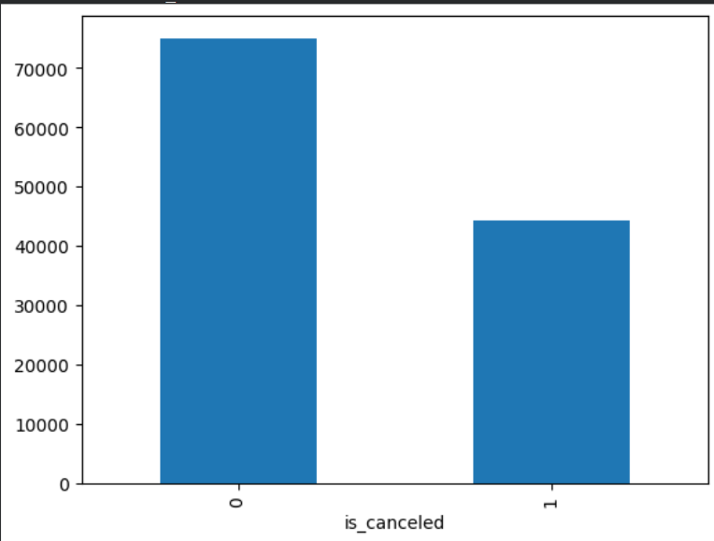
Exploratory Data Analysis (EDA)
Visual Distribution
Target Balance: Using visualizations, we confirmed the distribution of canceled vs. non-canceled bookings.
Feature Importance: This analysis directly informed our feature selection, identifying the most influential variables for the Random Forest model.

Slide 13
03
Feature Engineering & Pre-processing

Slide 14
Feature Engineering & Pre-processing
Behavioral Feature Synthesis
Creation of Aggregate Metrics: We developed new features like total_people (sum of adults, children, and babies) and total_stay to provide a holistic view of booking requirements.
Logic: Combining raw columns into synthesized metrics helps the model capture behavioral trends rather than fragmented data points.
Categorical Encoding: Used LabelEncoder to convert 12 qualitative variables (such as hotel, market_segment, and meal) into machine-readable numeric formats.
Logic: Combining raw columns into synthesized metrics helps the model capture behavioral trends rather than fragmented data points.
Numeric Refinement: Removed logical anomalies, such as negative values in the ADR column, to ensure data integrity.

Slide 15
Feature Engineering & Pre-processing
Categorical Transformation
lb = LabelEncoder(): This command initializes a LabelEncoder to convert textual categories into unique numeric identifiers.
categorical_cols_to_encode: A predefined list of columns, such as hotel, customer_type, market_segment, and distribution_channel, are identified for encoding.
Encoding Loop: A for-loop iterates through these columns, automatically transforming descriptive strings into integer labels to make the dataset compatible with mathematical modeling.

Slide 16

04
Model Training & Evaluation

Slide 17
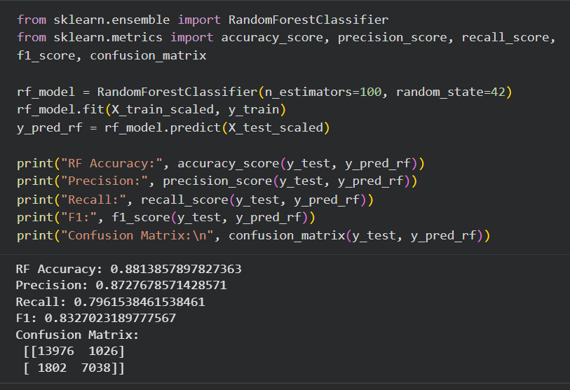
Model Training & Evaluation
Algorithmic Approach
Model Selection: We implemented a Random Forest Classifier, an ensemble learning method chosen for its robustness and ability to handle complex feature interactions.
Hyperparameter Tuning: Applied optimization techniques to refine the model's performance and prevent overfitting.
Feature Importance: The model utilized key predictors identified during EDA, such as lead_time , deposit_type, and adr.

Slide 18
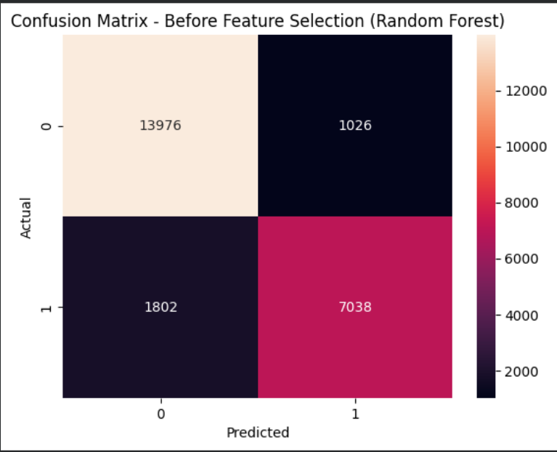
Model Training & Evaluation
Model Performance ( Before Feature Selection )
Model Configuration: Running the Random Forest classifier on the full set of processed features.
Confusion Matrix Analysis:
True Negatives (13,976): Strong performance in identifying confirmed bookings.
True Positives (7,038) : Successfully captured a large portion of cancellations.
Observations: While the initial accuracy is high, the model is processing many redundant variables which can lead to over-fitting andslower inference times.
Goal: Streamline the model by identifying the most influential predictors to improve efficiency without sacrificing significant accuracy.
Before feature selections

Slide 19
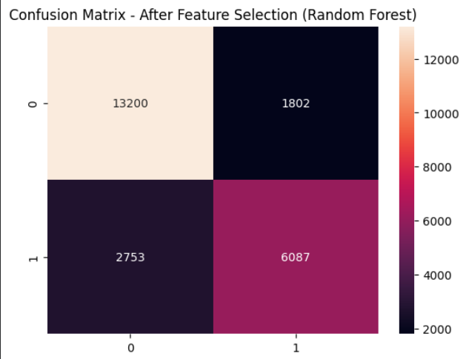
Model Training & Evaluation
Model Performance ( After Feature Selection )
Feature Refinement: We narrowed down the variables to the top contributors (e.g., lead_time, deposit type, adr) as identified during EDA.
Optimized Matrix Analysis:
Results: The model maintained a robust predictive power with 13,200 True Negatives and 6,087 True Positives.
Accuracy: Achieved a final stable accuracy of 87%.Strategic
Advantage:
Reduced Complexity: The model is now lighter and faster, making it more suitable for real-time hotel booking systems.
Generalization: By removing "noise" (redundant features), the model is more likely to perform accurately on new, unseen data.
after feature selections

Slide 20



Random Forest achieved the best performance among all models, providing the highest accuracy and a strong balance between precision and recall.
Performanc
Logistic Regression
Decision Tree
Random Forest

Slide 21
Conclusion
This project successfully applied machine learning techniques to predict hotel booking cancellations. The selected model can help hotels:
• Anticipate cancellations
• Improve revenue management
• Optimize booking strategies
Future improvements may include:
• Using more advanced models
• Hyperparameter tuning
• Deploying the model in a real-world system

Slide 22
Thank You

